Slide 1
FHIR Intro for Developers
Lloyd McKenzie
2018-04-17

Slide 2

Who am I?
Name: Lloyd McKenzie
Company: Gevity
Background:
One of FHIR’s 3 initial editors
Co-chair FMG, FHIR-I and MnM
HL7 Fellow
Heavily involved in HL7 and healthcare exchange for last 17 years (v2, v3, CDA, etc.)
lmckenzie@gevityinc.com

Slide 3


This presentation
Can be downloaded here:
https://github.com/FHIR/documents/blob/master/presentations/2018-04%20FHIR%20North/Intro%20for%20Developers.pptx
Is licensed for use under the Creative Commons, specifically:
Creative Commons Attribution 3.0 Unported License
(Do with it as you wish, so long as you give credit)
Credit for many of these slides:
James Agnew Mirjam Baltus

Slide 4
Learning Objectives
Know how to navigate the FHIR specification
Understand key FHIR features relevant to all implementations
Know how to find and perform basic functions using the Java (HAPI) reference implementation
Know how to find and perform basic functions using the .NET (C#) reference implementation
Notes:
Have < 3 hours so focus is more on “identifying considerations” than deeply exploring options

Slide 5
Assumptions
You already know what FHIR is or have attended an “Introduction to FHIR” tutorial of some sort
If not, check out http://bit.ly/fhirintro
You’re familiar with either Java or .NET development

Slide 6
What’s a Code Camp??
Chance to get up to speed/build skills
Learn by doing
Lots of support available if you get stuck
Guided exercises to work through
http://bit.ly/FHIRNorth2018
Chance to integrate with Canadian-based systems

Slide 7
Navigating the FHIR spec
(for developers)

Slide 8
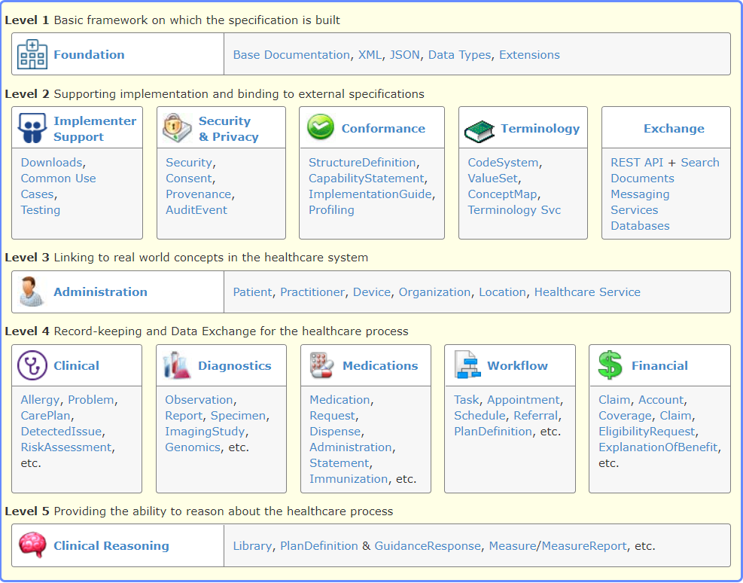
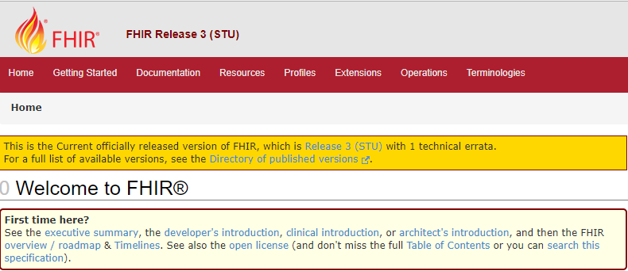
Navigating FHIR
http://hl7.org/fhir

Slide 9
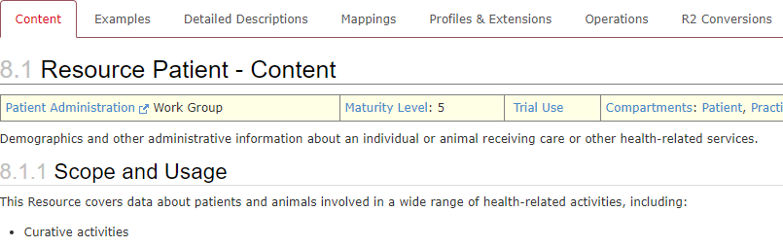
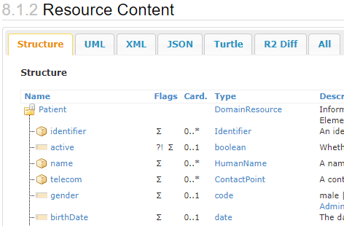
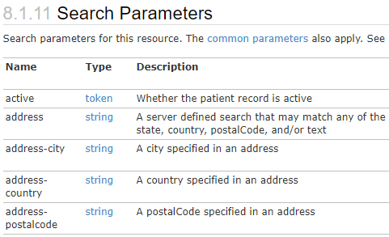
Navigating a resource

Slide 10
FHIR Java

Slide 11
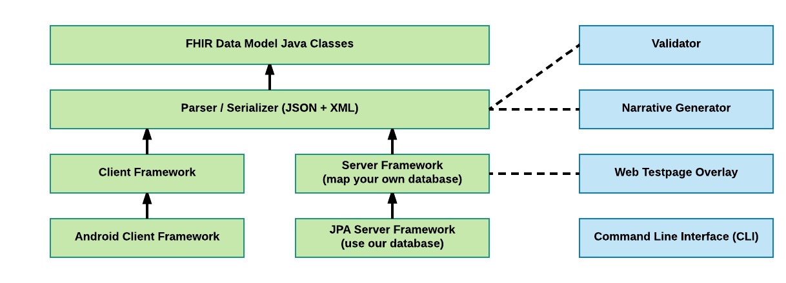
HAPI FHIR Modules
Components
Core Modules
Utilities

Slide 12
Data Model / Structure Classes
Part 1: Model, Parser, and Client

Slide 13
HAPI Versioning
HAPI version number != FHIR version number
HAPI FHIR version number != HAPI HL7v2 version number
 | FHIR DSTU1 | FHIR DSTU2 | FHIR R3 | FHIR R4
HAPI FHIR 1.0 | Yes | Draft
HAPI FHIR 2.0 | Yes | Yes | Draft
HAPI FHIR 2.5 | Yes | Yes | Yes
HAPI FHIR 3.0.0 |  | Yes | Yes | Draft
* Not all versions are shown here

Slide 14
Structures JARs
HAPI supports multiple versions of FHIR via different “structures JARs”
FHIR Version
HAPI Version
Patient Resource Models
Patient Resource Models
Patient Resource Models
hapi-fhir-structures-dstu-2.5.jar
Patient Resource Models
ca.uhn.fhir.model.dstu.resources.Patient
hapi-fhir-structures-dstu2-3.2.0.jar
ca.uhn.fhir.model.dstu2.resources.Patient
hapi-fhir-structures-dstu3-3.2.0.jar
org.hl7.fhir.dstu3.model.Patient
hapi-fhir-structures-r4-3.2.0.jar
org.hl7.fhir.r4.model.Patient

Slide 15
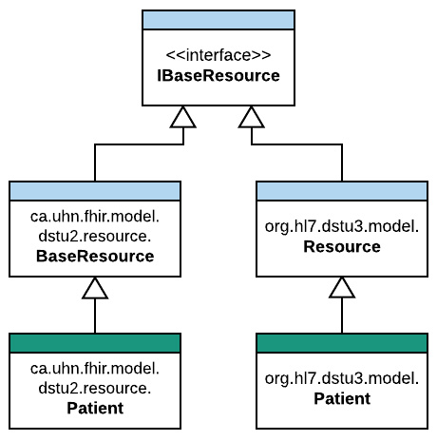
Structure Classes:
Resources
HAPI Defines several sets of classes which form the data model
Resource definition classes implement IBaseResource
Examples: Patient, CarePlan, Encounter, Practitioner, Medication

Slide 16
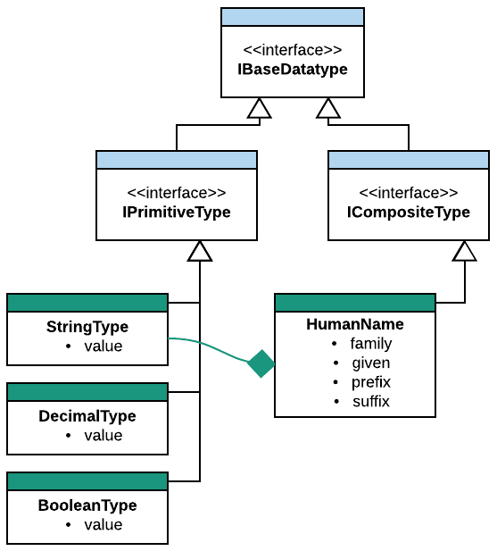
Structure Classes:
Datatypes
HAPI also defines a class for each data type
Primitive classes are named [name]Type
Primitive types include: StringType, BooleanType
Composite types include: Address, Ratio, HumanName

Slide 17
Creating A Resource
public class Example01_CreateAPatient {
public static void main(String[] theArgs) {
// Create a resource instance
Patient pat = new Patient();
// Add a "name" element
HumanName name = pat.addName();
name.setFamily("Simpson").addGiven("Homer").addGiven("J");
// Add an "identifier" element
Identifier identifier = pat.addIdentifier();
identifier.setSystem("http://acme.org/MRNs").setValue("7000135");
// Model is designed to be chained
pat.addIdentifier().setSystem("http://acme.org/MRNs").setValue("12345");
}
}

Slide 18
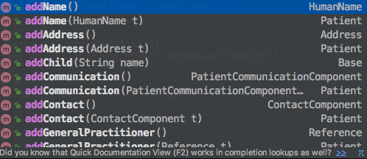
Use your IDE Autocomplete
public class Example01_CreateAPatient {
public static void main(String[] theArgs) {
// Create a resource instance
Patient pat = new Patient();
// Add a "name" element
HumanName name = pat.addName();
name.setFamily("Simpson").addGiven("Homer").addGiven("J");
// Add an "identifier" element
Identifier identifier = pat.addIdentifier();
identifier.setSystem("http://acme.org/MRNs").setValue("7000135");
// Model is designed to be chained
pat.addIdentifier().setSystem("http://acme.org/MRNs").setValue("12345");
}
}

Slide 19
Enumerated Types
public class Example02_EnumeratedTypes {
public static void main(String[] theArgs) {
Patient pat = new Patient();
pat.addName().setFamily("Simpson").addGiven("Homer").addGiven("J");
pat.addIdentifier().setSystem("http://acme.org/MRNs").setValue("7000135");
// Enumerated types are provided for many coded elements
ContactPoint contact = pat.addTelecom();
contact.setUse(ContactPoint.ContactPointUse.HOME);
contact.setSystem(ContactPoint.ContactPointSystem.PHONE);
contact.setValue("1 (416) 340-4800");
pat.setGender(Enumerations.AdministrativeGender.MALE);
}
}

Slide 20
Primitive Types
DateTimeType effective = new DateTimeType();
effective.setValue(new Date());
effective.setValue(new Date(), TemporalPrecisionEnum.MINUTE);
effective.setValueAsString("2017-09-11T14:35:00-07:00");
BooleanType active = new BooleanType();
active.setValue(true);
active.setValueAsString("true");
DecimalType value = new DecimalType();
value.setValue(1.2d);
value.setValueAsString("1.20000");
Primitive Representation
String Representation

Slide 21
Primitive Types (2)
Observation obs = new Observation();
// These are equivalent
obs.setComment("This is a comment");
obs.setCommentElement(new StringType("This is a comment"));
// Get the primitive or get the FHIR type
String comment = obs.getComment();
StringType commentElement = obs.getCommentElement();

Slide 22
Parser / Serializer
Part 1: Model, Parser, and Client

Slide 23
The Context
The starting point for much of the HAPI-FHIR API is the FhirContext class
FhirContext acts as a factory for the rest of the API, including the two parsers:
XmlParser
JsonParser
FhirContext is designed to be created once and reused (important for performance!)

Slide 24
Encoding A Resource
public class Example04_EncodeResource {
public static void main(String[] theArgs) {
// Create a Patient
Patient pat = new Patient();
pat.addName().addFamily("Simpson").addGiven("Homer").addGiven("J");
pat.addIdentifier().setSystem("http://acme.org/MRNs").setValue("7000135");
pat.addTelecom().setUse(ContactPointUse.HOME).setSystem(ContactPointSystem.PHONE).setValue("1 (416) 340-4800");
pat.setGender(AdministrativeGender.MALE);
// Create a context
FhirContext ctx = FhirContext.forDstu3();
// Create a JSON parser
IParser parser = ctx.newJsonParser();
parser.setPrettyPrint(true);
String encode = parser.encodeResourceToString(pat);
System.out.println(encode);
}
}

Slide 25
Encoding A Resource
{
"resourceType": "Patient",
"identifier": [
{
"system": "http://acme.org/MRNs",
"value": "7000135"
}
],
"name": [
{
"family": "Simpson",
"given": [
"Homer",
"J"
]
}
],
"telecom": [
{
"system": "phone",
"value": "1 (416) 340-4800",
"use": "home"
}
],
"gender": "male"
}
public class Example04_EncodeResource {
public static void main(String[] theArgs) {
// Create a Patient
Patient pat = new Patient();
pat.addName().addFamily("Simpson").addGiven("Homer").addGiven("J");
pat.addIdentifier().setSystem("http://acme.org/MRNs").setValue("7000135");
pat.addTelecom().setUse(ContactPointUse.HOME).setSystem(ContactPointSystem.PHONE).setValue("1 (416) 340-4800");
pat.setGender(AdministrativeGender.MALE);
// Create a context
FhirContext ctx = FhirContext.forDstu3();
// Create a JSON parser
IParser parser = ctx.newJsonParser();
parser.setPrettyPrint(true);
String encode = parser.encodeResourceToString(pat);
System.out.println(encode);
}
}

Slide 26
Parsing A Resource
public class Example05_ParseResource {
public static void main(String[] theArgs) {
String resourceBody = "{\"resourceType\":\"Patient\",\"identifier\":[{\"system\":\"http://acme.org/MRNs\",\"value\":\"7000135\"}],\"name\":[{\"family\":[\"Simpson\"],\"given\":[\"Homer\",\"J\"]}]}";
// Create a context
FhirContext ctx = FhirContext.forDstu3();
// Create a JSON parser
IParser parser = ctx.newJsonParser();
Patient pat = parser.parseResource(Patient.class, resourceBody);
List<Identifier> identifiers = pat.getIdentifier();
String idSystemString = identifiers.get(0).getSystem();
String idValueString = identifiers.get(0).getValue();
System.out.println(idSystemString + " " + idValueString);
}
}
http://acme.org/MRNs - 7000135

Slide 27
Client Framework
Part 1: Model, Parser, and Client

Slide 28
Recap on REST
FHIR defines basic CRUD operations that can be performed on a FHIR compliant server (*not a complete list)
Name | HTTP URL
type create | POST http://base/[type]
instance read | GET http://base/[type]/[id]
instance update | PUT http://base/[type]/[id]
instance delete | DELETE http://base/[type]/[id]
type search | GET http://base/[type]?[params]

Slide 29
Clients:
Two Distinct Flavours in HAPI FHIR
Annotation Generic/Fluent
public interface SampleClient extends IRestfulClient {
@Create
MethodOutcome create(@ResourceParam Patient thePatient);
@Read
Patient read(@IdParam IdType theId);
}
MethodOutcome outcome = client
.create()
.resource(pat)
.execute();
You create an annotated interface for your specific needs
Similar to JAX-RS or Spring REST (but does not use these frameworks)
Use chained method calls to do anything you need
This is generally easier and more popular

Slide 30
Clients:
Two Distinct Flavours in HAPI FHIR
Annotation Generic/Fluent
public interface SampleClient extends IRestfulClient {
@Create
MethodOutcome create(@ResourceParam Patient thePatient);
@Read
Patient read(@IdParam IdType theId);
}
MethodOutcome outcome = client
.create()
.resource(pat)
.execute();
Docs:
http://hapifhir.io/ doc_rest_client_annotation.html
Docs:
http://hapifhir.io/doc_rest_client.html

Slide 31
Create a Patient
public class Example06_ClientCreate {
public static void main(String[] theArgs) {
Patient pat = new Patient();
pat.addName().setFamily("Simpson").addGiven("Homer").addGiven("J");
pat.addIdentifier().setSystem("http://acme.org/MRNs").setValue("7000135");
pat.setGender(AdministrativeGender.MALE);
// Create a context
FhirContext ctx = FhirContext.forDstu3();
// Create a client
String serverBaseUrl = "http://fhirtest.uhn.ca/baseDstu3";
IGenericClient client = ctx.newRestfulGenericClient(serverBaseUrl);
// Use the client to store a new resource instance
MethodOutcome outcome = client
.create()
.resource(pat)
.execute();
// Print the ID of the newly created resource
System.out.println(outcome.getId());
}
}

Slide 32
Update a Patient
public class Example07_ClientReadAndUpdate {
public static void main(String[] theArgs) {
// Create a client
String serverBaseUrl = "http://fhirtest.uhn.ca/baseDstu3";
FhirContext ctx = FhirContext.forDstu3();
IGenericClient client = ctx.newRestfulGenericClient(serverBaseUrl);
// Use the client to read back the new instance using the ID we retrieved from the read
Patient patient = client
.read()
.resource(Patient.class)
.withId("example")
.execute();
// Print the ID of the newly created resource
System.out.println("Found ID: " + patient.getId());
// Change the gender
patient.setGender(patient.getGender() == AdministrativeGender.MALE ? AdministrativeGender.FEMALE : AdministrativeGender.MALE);
// Update the patient
MethodOutcome outcome = client
.update()
.resource(patient)
.execute();
System.out.println("Now have ID: " + outcome.getId());
}
}

Slide 33
Searching
FHIR defines a powerful search mechanism
Searches are specially crafted URLs to express queries such as:
Find a Patient with the given Identifier
Find all Patients with given gender and DOB
Find all lab reports for a given patient identifier with an “abnormal” interpretation

Slide 34
Searching (2)
Searching is powerful! Learn about it at
http://hl7.org/fhir/search.html
For now, let’s imagine a search for a Patient named “Test” whose birthdate is before 2014

Slide 35
Searching
public class Example08_ClientSearch {
public static void main(String[] theArgs) {
FhirContext ctx = FhirContext.forDstu3();
IGenericClient client = ctx.newRestfulGenericClient("http://fhirtest.uhn.ca/baseDstu3");
// Build a search and execute it
Bundle response = client.search()
.forResource(Patient.class)
.where(Patient.NAME.matches().value("Test"))
.and(Patient.BIRTHDATE.before().day("2014-01-01"))
.count(100)
.returnBundle(Bundle.class)
.execute();
// How many resources did we find?
System.out.println("Responses: " + response.getTotal());
// Print the ID of the first one
System.out.println("First response ID: " + response.getEntry().get(0).getResource().getId());
}
}

Slide 36
Other Operations
Lots of other FHIR operations are supported in the client:
History, CapabilityStatement, Transactions, Delete, etc.
There is also lots of support for advanced features:
Version aware updates, Get-if-newer, etc.
Reminder about docs:
http://hapifhir.io/doc_rest_client.html

Slide 37
Get Help!
See our website for documentation: http://hapifhir.io
We also have a Google Group / Mailing List https://groups.google.com/d/forum/hapi-fhir
Zulip is great but less monitored by the HAPI FHIR team

Slide 38
FHIR .NET

Slide 39
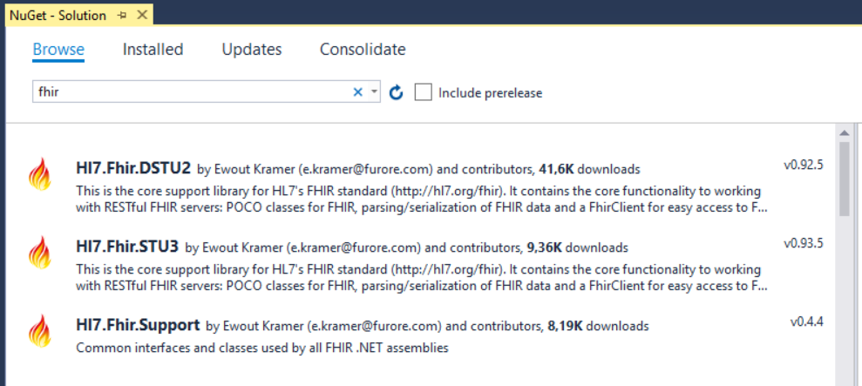
First step
Adding the Hl7.Fhir package to your solution
NuGet Package manager, Hl7.Fhir.STU3 package

Slide 40
Hl7.Fhir.STU3
Core contents
Model – classes generated from the spec
REST functionality – FhirClient
Parsers and Serializers
Helper functions
Source on GitHub: http://github.com/ewoutkramer/fhir-net-api

Slide 41
A FHIR Resource in C# - classes and enums
public partial class Observation : Hl7.Fhir.Model.DomainResource
/// <summary>
/// Codes providing the status of an observation.
/// (url: http://hl7.org/fhir/ValueSet/observation-status)
/// </summary>
public enum ObservationStatus {Registered, Preliminary, Final, …}
var obs = new Observation();
obs.Status = ObservationStatus.Preliminary;

Slide 42
A FHIR Resource in C# - datatypes and lists
public CodeableConcept Code { get; set; }
obs.Code = new CodeableConcept("http://example.org", "EX123",
"Example code 123");
public List<Identifier> Identifier { get; set; }
obs.Identifier.Add(new Identifier("http://example.org", "123456"));

Slide 43
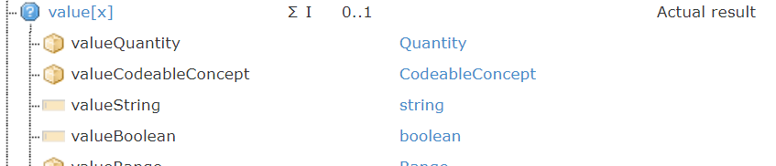
A FHIR Resource in C# - choice properties
public CodeableConcept Code { get; set; }
public Element Value { get; set; }
var qty = new Quantity { Value = 25, Unit = "sec", System = "http://unitsofmeasure.org", Code = "s" }; obs.Value = qty;

Slide 44
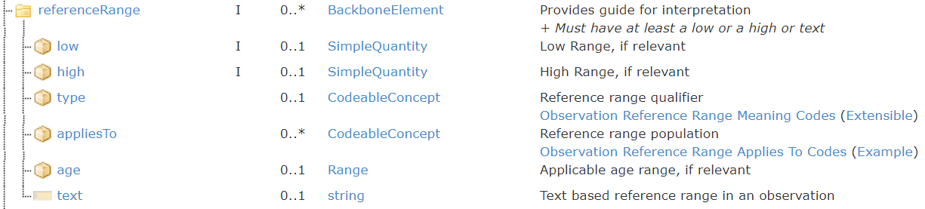
A FHIR Resource in C# - components
public partial class ReferenceRangeComponent : BackboneElement { … }
var refRange = new Observation.ReferenceRangeComponent(); // fill the values obs.ReferenceRange.Add(refRange);

Slide 45
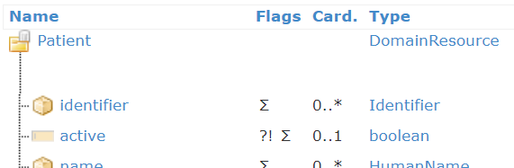
A FHIR Resource in C# - (non) primitives
/// <summary> /// Whether this patient's record is /// in active use /// </summary>
public bool? Active { … }
public Hl7.Fhir.Model.FhirBoolean ActiveElement { … }
var pat = new Patient();
pat.Active = true;
pat.ActiveElement = new FhirBoolean(true);
// or

Slide 46
Why would you use the non-primitive version?
var name = new HumanName();
name.Given = new string[] { "Mirjam" }; // or name.GivenElement.Add(new FhirString("Mirjam"));
name.Family = "Baltus-Bakker";
Adding extensions cannot be done on primitives!

Slide 47
Why would you use the non-primitive version?
var name = new HumanName();
name.Given = new string[] { "Mirjam" }; // or name.GivenElement.Add(new FhirString("Mirjam"));
name.Family = "Baltus-Bakker";
Adding extensions cannot be done on primitives!
name.FamilyElement.AddExtension(
"http://hl7.org/fhir/StructureDefinition/humanname-partner-name", new FhirString("Baltus"));

Slide 48
Using the FHIR Client
For a list of test servers, see Publicly Available FHIR Servers
var client = new FhirClient("http://vonk.furore.com");
// client options client.PreferredFormat = ResourceFormat.Xml; client.PreferredReturn = Prefer.ReturnRepresentation;

Slide 49
C(RUD)
var obs = new Observation(); obs.Status = ObservationStatus.Preliminary; obs.Code = new CodeableConcept("http://example.org", "EX123", "Example code 123"); // fill in mandatory fields, plus other fields you have data for
// send the observation to the server to be created
var result = client.Create<Observation>(obs);
// note that this could generate an error, // so setup error handling to catch exceptions

Slide 50
(C)RUD
// read a resource from the server
var pat = client.Read<Patient>("Patient/1");
// update a resource on the server
pat.Name.Add(HumanName.ForFamily("Kramer").WithGiven("Ewout"));
client.Update<Patient>(pat);
// delete a resource from the server
client.Delete(pat); // or
client.Delete("Patient/12345");

Slide 51
Making queries
var q = new SearchParams()
.Where("name=Ewout")
.Include("Patient:organization")
.LimitTo(10)
.SummaryOnly()
.OrderBy("birthdate", SortOrder.Descending);
q.Add("gender", "male");
Bundle result = client.Search<Patient>(q);

Slide 52
Paging through a Bundle
while (result != null) { foreach (var e in result.Entry) { Patient p = (Patient)e.Resource; // do something with the resource } result = client.Continue(result, PageDirection.Next); }

Slide 53
Resource Identity
pat.ResourceIdentity().HasBaseUri; pat.ResourceIdentity().HasVersion;
pat.ResourceIdentity().BaseUri; pat.ResourceIdentity().ResourceType;
var id = new ResourceIdentity("Patient/3") .WithBase("http://example.org/fhir");
var id2 = ResourceIdentity.Build(UrnType.OID, "1.2.3.4.5.6");

Slide 54

Questions?
http://hl7.org/fhir lmckenzie@gevityinc.com

